Slide 1


Profiting from Global Supply Chain Analytics

Slide 3
Collecting Data
Income statement : Report of a company’s financial performance over a specific accounting period.
Balance sheet : A statement of the assets, liabilities, and capital of a business or other organization at a particular point in time, detailing the balance of income and expenditure over the preceding period.
Cash flow statement : A financial statement that provides aggregate data regarding all cash inflows a company receives from its ongoing operations and external investment sources. It also includes all cash outflows that pay for business activities and investments during a given period.

Slide 4

How this model can help?
This machine learning model will be quite helpful in such a situation where we need to find a profit based on how much we are spending in the market and for the market. In a nutshell, this machine learning model will help to find out the profit based on the amount which we spend.

Slide 5
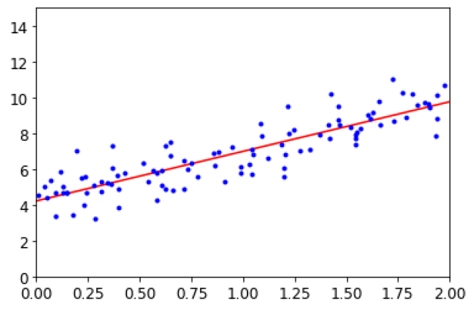
Linear Regression Algorithm

Slide 6
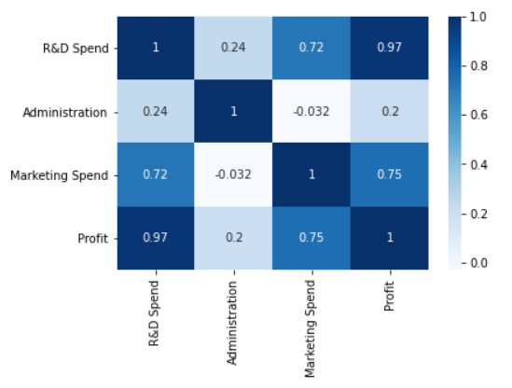
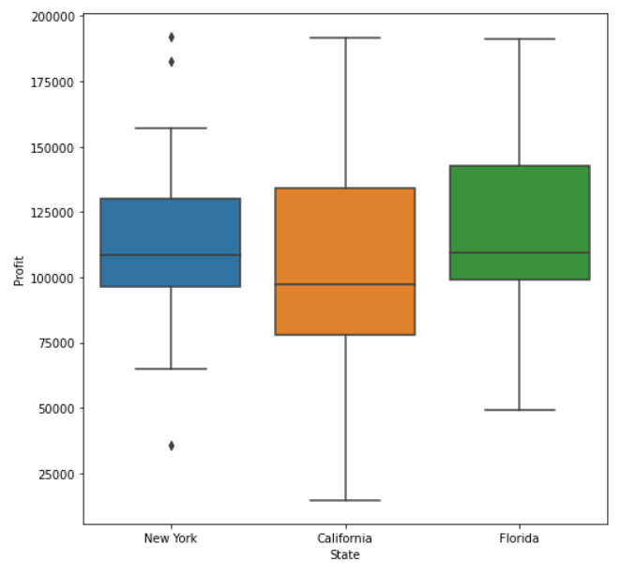
Output for the code
Heat Map
Box Plot

Slide 7
Benefits of profit prediction
Cash flow
Credit
Inventory control
Resource supplies
Production scheduling
Marketing
Staffing decisions
Product and price planning
Sales process

Slide 8


Slide 9


